Slide 1
AWS

Slide 2
Table of Contents
Getting Started with AWS
AWS Identity & Access Management (AWS IAM)
Amazon EC2 – Basics
Amazon EC2 – Associate
Amazon EC2 – Instance Storage
High Availability & Scalability
RDS, Aurora & ElastiCache
Amazon Route 53
Classic Solutions Architecture
Amazon S3

Slide 3

What’s AWS?
• AWS (Amazon Web Services) is a Cloud Provider
• They provide you with servers and services that you can use on
demand and scale easily
• AWS has revolutionized IT over time
• AWS powers some of the biggest websites in the world
Amazon.com
Netflix

Slide 4
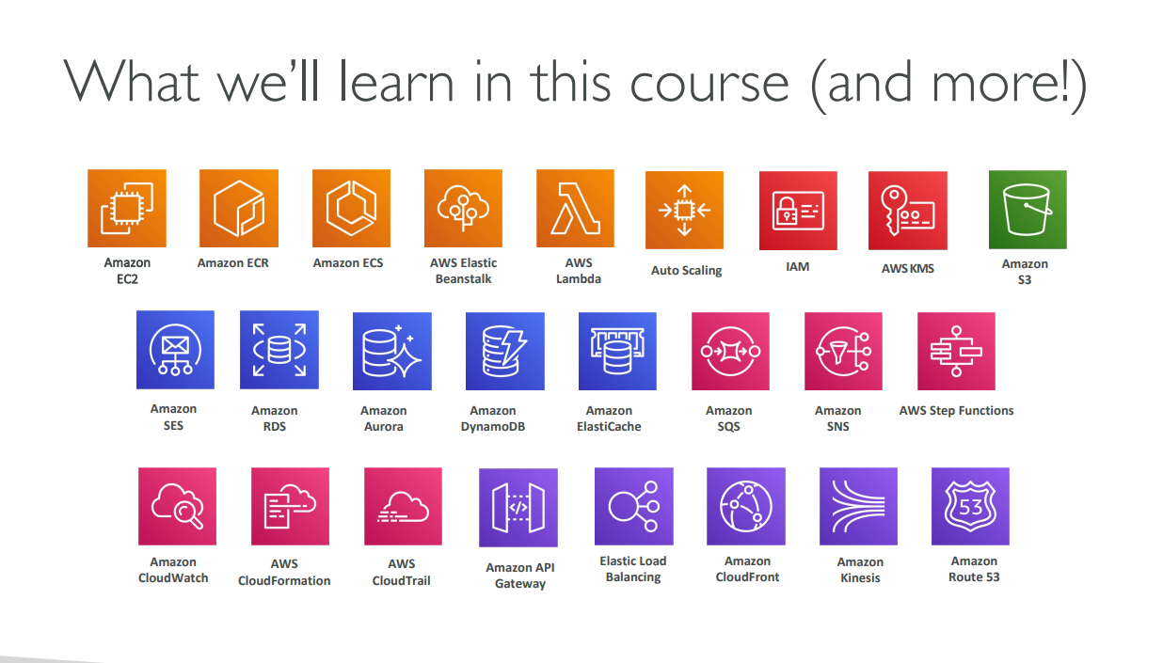

Slide 5
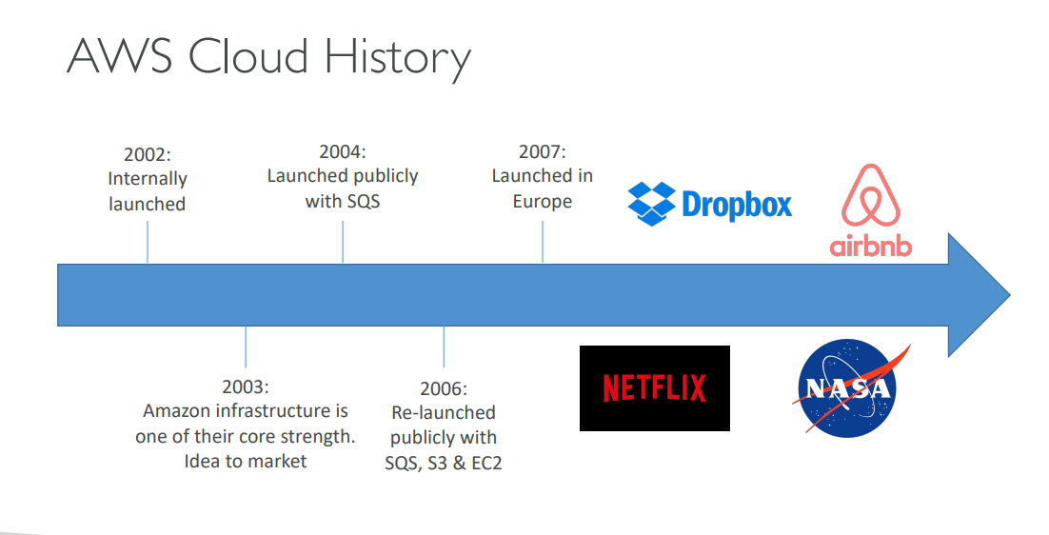

Slide 6
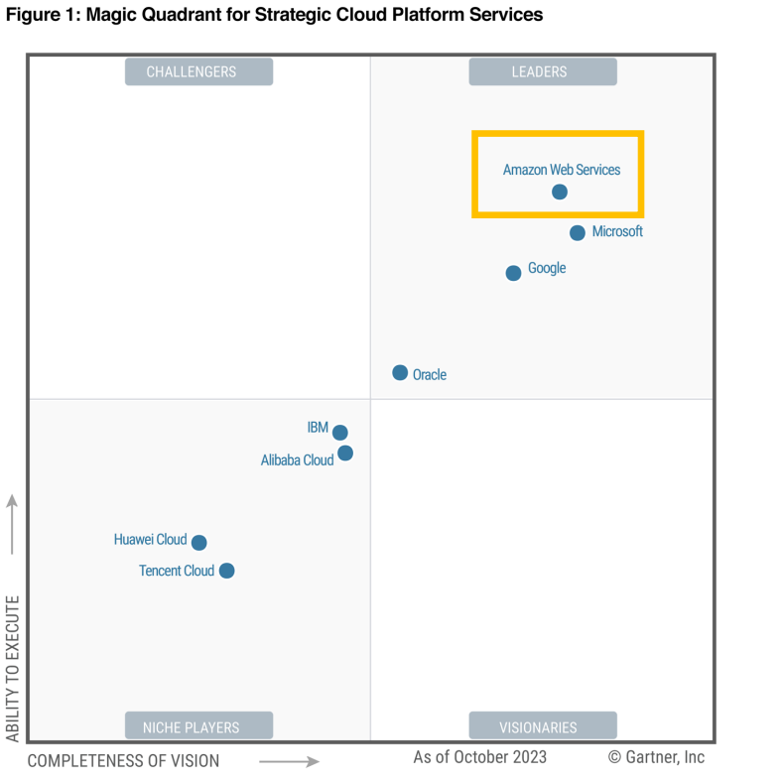
AWS Cloud Number Facts
• In 2023, AWS had $90 billion in annual revenue
• AWS accounts for 31% of the market in
Q1 2024 (Microsoft is 2nd with 25%)
• Pioneer and Leader of the AWS Cloud
Market for the 13th consecutive year
• Over 1,000,000 active users

Slide 7

AWS Cloud Use Cases
• AWS enables you to build sophisticated, scalable applications
• Applicable to a diverse set of industries
• Use cases include
• Enterprise IT, Backup & Storage, Big Data analytics
• Website hosting, Mobile & Social Apps
• Gaming

Slide 8
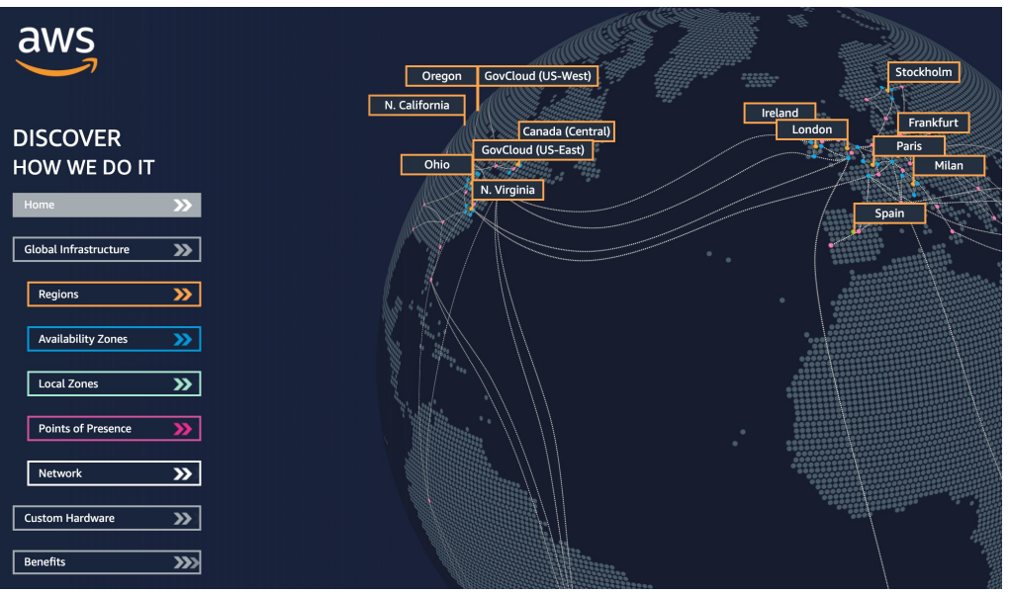
AWS Global Infrastructure
• AWS Regions
• AWS Availability Zones
• AWS Data Centers
• AWS Edge Locations / Points of Presence
• https://infrastructure.aws/

Slide 9
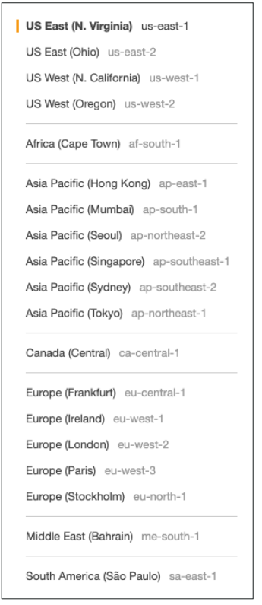
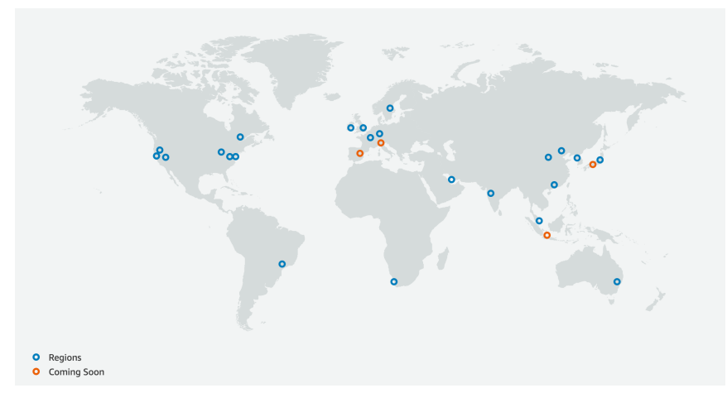
AWS Regions
• AWS has Regions all around the world
• Names can be us-east-1, eu-west-3…
• A region is a cluster of data centers
• Most AWS services are region-scoped
https://aws.amazon.com/about-aws/global-infrastructure/

Slide 10
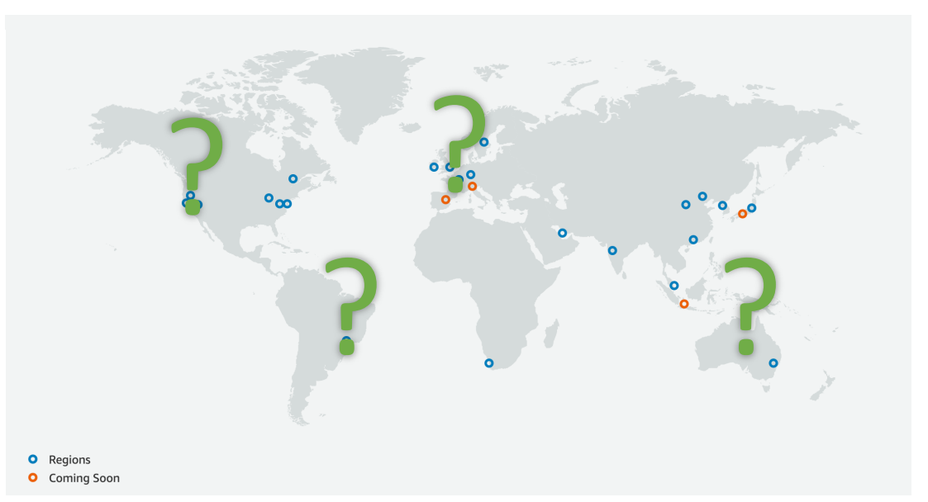
How to choose an AWS Region?
If you need to launch a new application, where should you do it?
Compliance with data governance and legal
requirements: data never leaves a region without
your explicit permission
Proximity to customers: reduced latency
Available services within a Region: new services
and new features aren’t available in every Region
Pricing: pricing varies region to region and is
transparent in the service pricing page

Slide 11
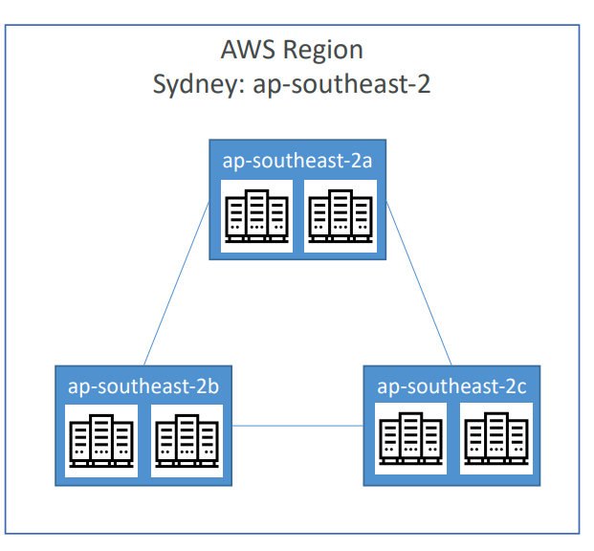
AWS Availability Zones
Each region has many availability zones (usually 3, min is 3, max is 6). Example:
ap-southeast-2a
ap-southeast-2b
ap-southeast-2c
Each availability zone (AZ) is one or more discrete data centers with redundant power, networking, and connectivity
They’re separate from each other, so that they’re isolated from disasters
They’re connected with high bandwidth, ultra-low latency networking

Slide 12
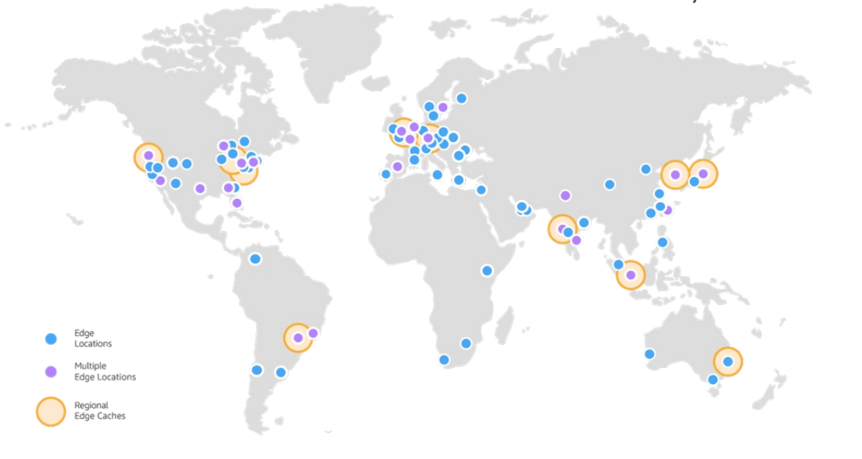
AWS Points of Presence (Edge Locations)
Amazon has 400+ Points of Presence (400+ Edge Locations & 10+ Regional Caches) in 90+ cities across 40+ countries
Content is delivered to end users with lower latency
https://aws.amazon.com/cloudfront/features/

Slide 13
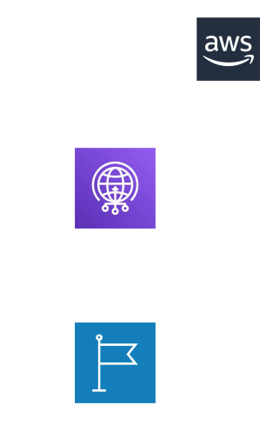
Tour of the AWS Console
AWS has Global Services:
Identity and Access Management (IAM)
Route 53 (DNS service)
CloudFront (Content Delivery Network)
WAF (Web Application Firewall)
Most AWS services are Region-scoped:
Amazon EC2 (Infrastructure as a Service)
Elastic Beanstalk (Platform as a Service)
Lambda (Function as a Service)
Rekognition (Software as a Service)
Region Table: https://aws.amazon.com/about-aws/global-infrastructure/regional-product-services

Slide 14
AWS Identity and Access Management (AWS IAM)

Slide 15
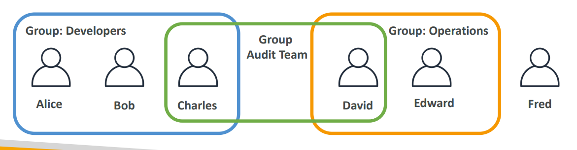
IAM: Users & Groups
IAM = Identity and Access Management, Global service
Root account created by default, shouldn’t be used or shared
Users are people within your organization, and can be grouped
Groups only contain users, not other groups
Users don’t have to belong to a group, and user can belong to multiple groups

Slide 16
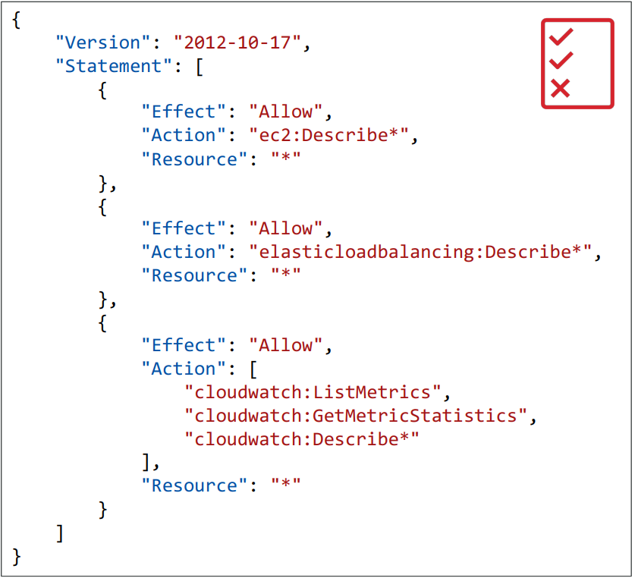
IAM: Permissions
Users or Groups can be assigned JSON documents called policies
These policies define the permissions of the users
In AWS you apply the least privilege principle: don’t give more permissions than a user needs

Slide 17
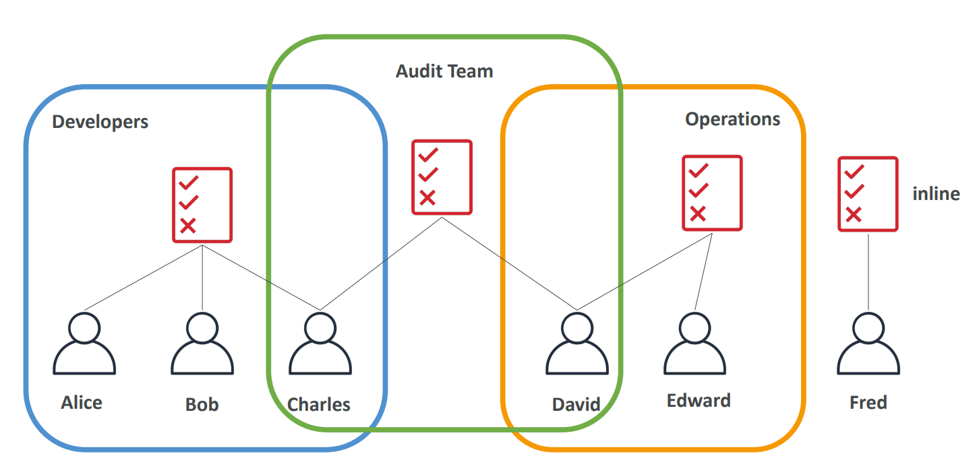
IAM Policies inheritance

Slide 18
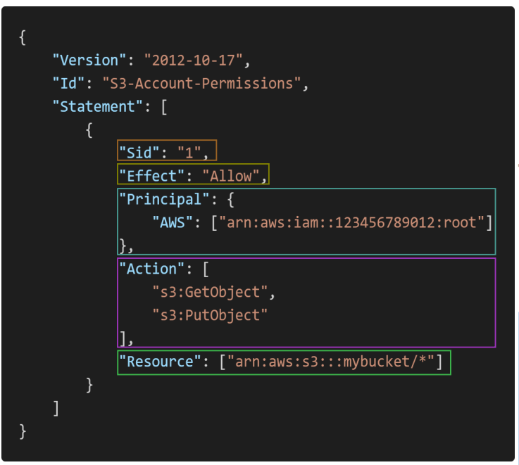
IAM Policies Structure
Consists of
Version: policy language version, always include “2012-10 -17”
Id: an identifier for the policy (optional)
Statement: one or more individual statements (required)
Statements consists of
Sid: an identifier for the statement (optional)
Effect: whether the statement allows or denies access (Allow, Deny)
Principal: account/user/role to which this policy applied to
Action: list of actions this policy allows or denies
Resource: list of resources to which the actions applied to
Condition: conditions for when this policy is in effect (optional)

Slide 19
IAM – Password Policy
Strong passwords = higher security for your account
In AWS, you can setup a password policy:
Set a minimum password length
Require specific character types:
including uppercase letters
lowercase letters
numbers
non-alphanumeric characters
Allow all IAM users to change their own passwords
Require users to change their password after some time (password expiration)
Prevent password re-use

Slide 20
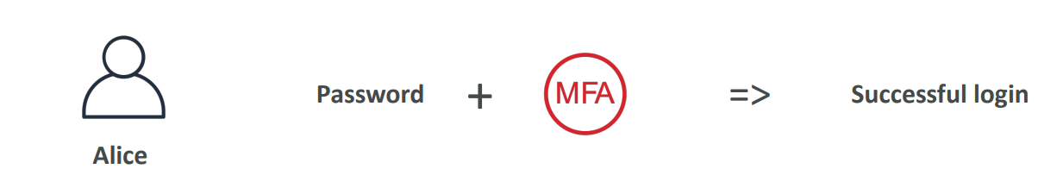
Multi Factor Authentication – MFA
• Users have access to your account and can possibly change
configurations or delete resources in your AWS account
• You want to protect your Root Accounts and IAM users
• MFA = password you know + security device you own
• Main benefit of MFA:
if a password is stolen or hacked, the account is not compromised

Slide 21
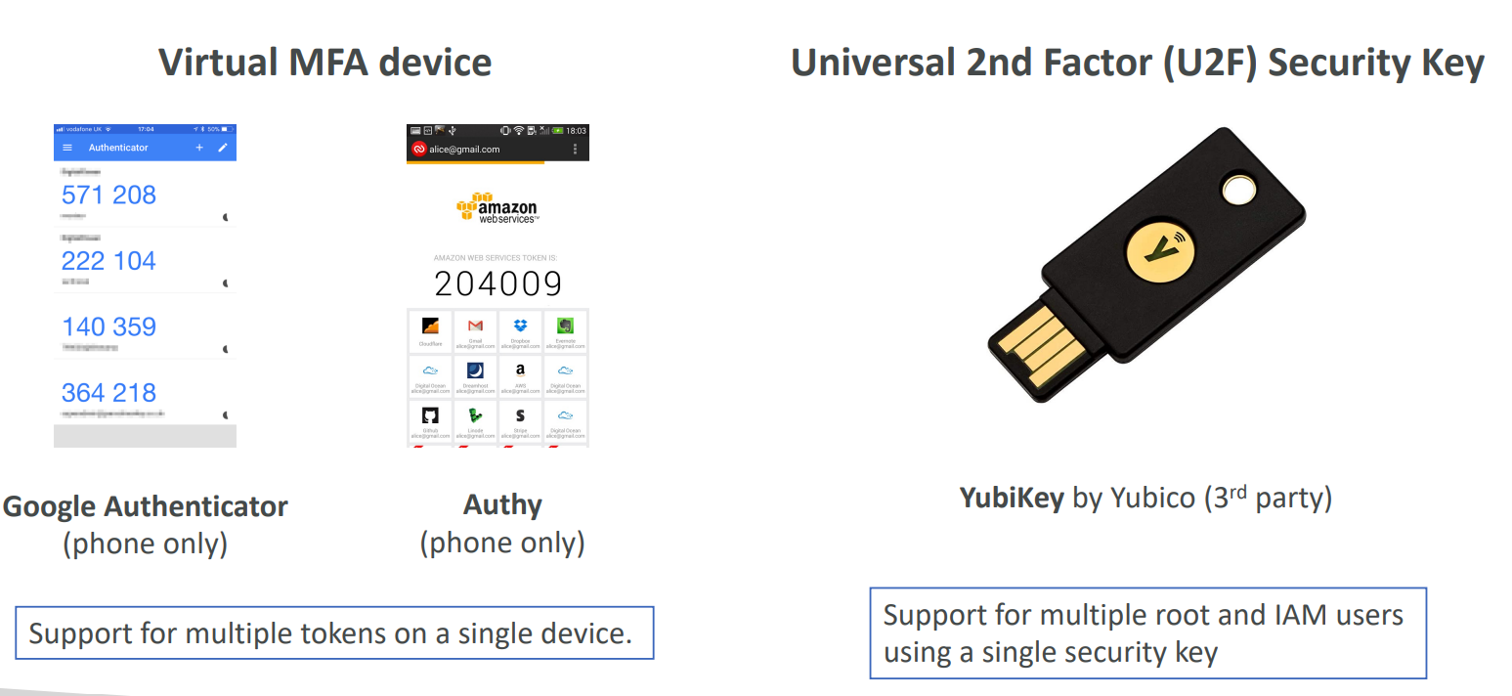
MFA devices options in AWS

Slide 22
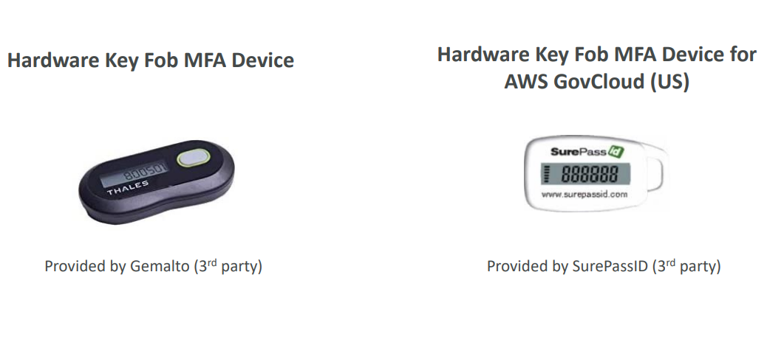
MFA devices options in AWS

Slide 23
How can users access AWS ?
To access AWS, you have three options:
AWS Management Console (protected by password + MFA)
AWS Command Line Interface (CLI): protected by access keys
AWS Software Developer Kit (SDK) - for code: protected by access keys
Access Keys are generated through the AWS Console
Users manage their own access keys
Access Keys are secret, just like a password. Don’t share them
Access Key ID ~= username
Secret Access Key ~= password

Slide 24
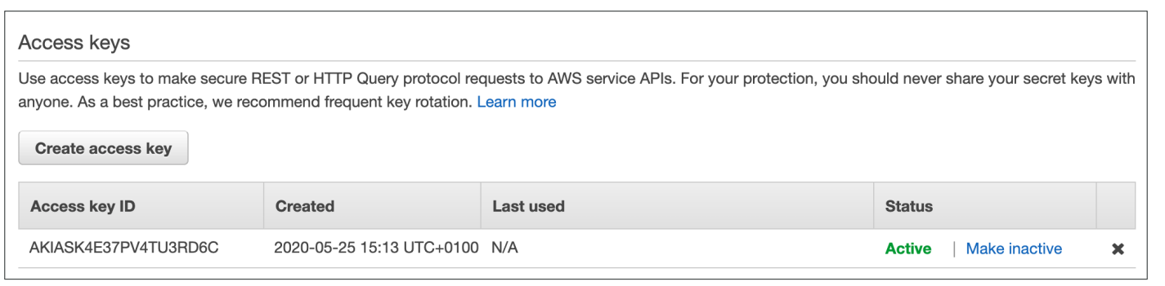
Example Access Keys
Access key ID: AKIASK4E37PV4983d6C -dummy
Secret Access Key: AZPN3zojWozWCndIjhB0Unh8239a1bzbzO5fqqkZq
Remember: don’t share your access keys

Slide 25
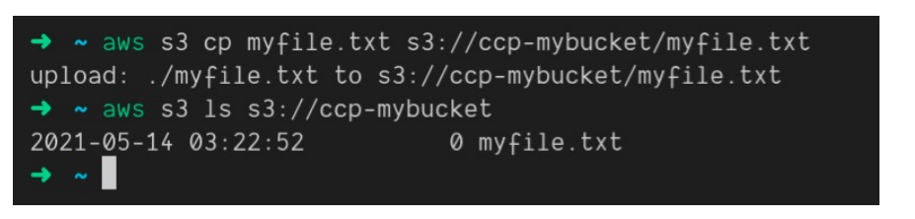
What’s the AWS CLI?
A tool that enables you to interact with AWS services using commands in
your command-line shell
Direct access to the public APIs of AWS services
You can develop scripts to manage your resources
It’s open-source https://github.com/aws/aws-cli
Alternative to using AWS Management Console

Slide 26
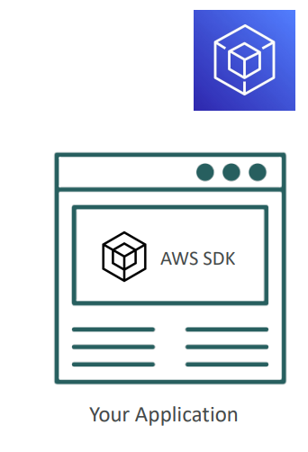
What’s the AWS SDK?
AWS Software Development Kit (AWS SDK)
Language-specific APIs (set of libraries)
Enables you to access and manage AWS services programmatically
Embedded within your application
Supports
SDKs (JavaScript, Python, PHP, .NET, Ruby, Java, Go, Node.js,C++)
Mobile SDKs (Android, iOS, …)
IoT Device SDKs (Embedded C, Arduino, …)
Example: AWS CLI is built on AWS SDK for Python

Slide 27
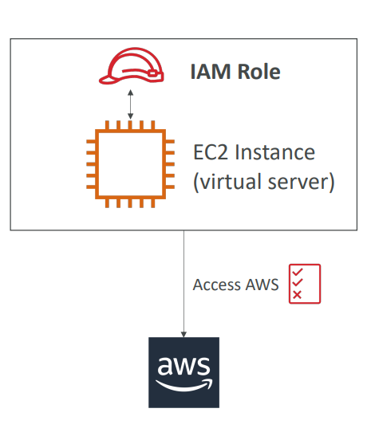
IAM Roles for Services
Some AWS service will need to
perform actions on your behalf
To do so, we will assign
permissions to AWS services
with IAM Roles
Common roles:
EC2 Instance Roles
Lambda Function Roles
Roles for CloudFormation

Slide 28
IAM Security Tools
IAM Credentials Report (account-level)
a report that lists all your account's users and the status of their various credentials
IAM Access Advisor (user-level) (Last Accessed)
Access advisor shows the service permissions granted to a user and when those services were last accessed.
You can use this information to revise your policies.

Slide 29
IAM Guidelines & Best Practices
Don’t use the root account except for AWS account setup
One physical user = One AWS user
Assign users to groups and assign permissions to groups
Create a strong password policy
Use and enforce the use of Multi Factor Authentication (MFA)
Create and use Roles for giving permissions to AWS services
Use Access Keys for Programmatic Access (CLI / SDK)
Audit permissions of your account using IAM Credentials Report & IAM Access Advisor
Never share IAM users & Access Keys

Slide 30
IAM Section – Summary
• Users: mapped to a physical user, has a password for AWS Console
• Groups: contains users only
• Policies: JSON document that outlines permissions for users or groups
• Roles: for EC2 instances or AWS services
• Security: MFA + Password Policy
• AWS CLI: manage your AWS services using the command-line
• AWS SDK: manage your AWS services using a programming language
• Access Keys: access AWS using the CLI or SDK
• Audit: IAM Credential Reports & IAM Access Advisor

